Slide 1
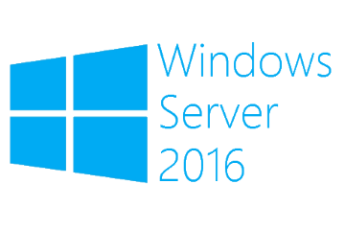
Enable Nested Virtualization
Megaseries

Slide 2
Info
A big new feature on Windows Server 2016
Permits administrators to make more complex test labs without a lot of hardware by creating Hyper-V virtual machines and installing other virtual machines in those
It is also used for Containers
It is not meant for production use (just test labs and containers)

Slide 3
Prerequisites
Nested virtualization is supported starting with Windows Server 2016 (for host and VMs)
An Intel processor with VT-x and EPT is needed
The host VM should not use dynamic memory
The host VM does not support checkpoints and live migration

Slide 4
Steps
Expose CPU virtualization extensions
Enable MAC address spoofing
Settings are enabled on a per VM basis and the VM has to be stopped

Slide 5

https://www.youtube.com/channel/UCcZ-jLbPwNr8E_v9-65n8Iw https://github.com/itknowledge4

